Slide 1
Chapter 15
How to work with fonts and printing

Slide 2
Objectives
Applied
Use the CSS3 @font-face selector, Google Web Fonts, or Adobe Typekit fonts to embed fonts in a web page.
Use the @media print selector to add the styles for printing a page to the style sheet for displaying the page.
Use a second style sheet for the styles that should be used for printing a web page.
Knowledge
In general terms, describe how the CSS3 @font-face selector works.
In general terms, describe the use of Google Web Fonts and Adobe Typekit fonts.

Slide 3
Objectives (cont.)
In general terms, describe the way that you format a web page for printing.
Describe three ways that you can provide the styles for printing a web page.
Describe the use of these properties for printing a page: display, page-break-before, page-break-after, orphans, and widows.
Explain why in (inches) is often used as the unit of measurement for printed pages.

Slide 4
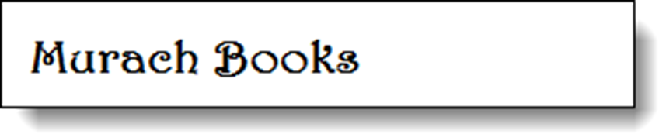
A heading that uses a font imported with CSS3
The CSS for embedding a font
@font-face {
font-family: Murach;
src: url("HARNGTON.TTF"); }
The CSS for applying the font to an HTML element
h1 {
font-family: Murach, sans-serif; }
The HTML for the element that the font is applied to
<h1>Murach Books</h1>

Slide 5
Where to find the fonts on your computer
On a Windows system
C:\Windows\Fonts
On a Mac OS system
System\Library\Fonts
How to import a font
Copy the file for the font family into a folder for your website.
In the CSS for the page, code a rule set for the @font-face selector.
Use the font-family property to provide a name for the imported font family, and use the src property to locate the font file.

Slide 6
How to apply an imported font to an HTML element
In the rule set for the HTML element, use the name that you gave the font as the value for the font-family property.
List one or more other font families in case the browser doesn’t support the CSS3 @font-face selector.

Slide 7
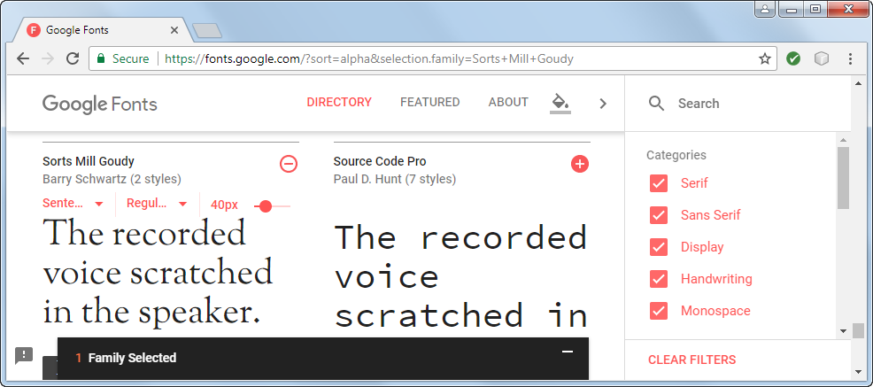
The Google Web Fonts website

Slide 8
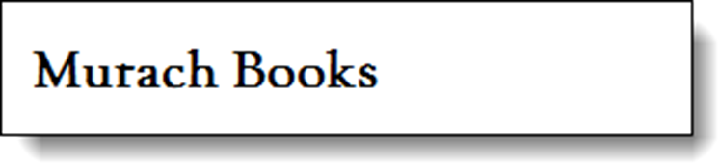
A heading that uses a Google Web Font
The HTML for the element that the font is applied to
<h1>Murach Books</h1>
The CSS for importing the Google Web Font
<link href= "http://fonts.googleapis.com/css?family=Sorts+Mill+Goudy"
rel="stylesheet">
The CSS for applying the font to an HTML element
h1 { font-family: "Sorts Mill Goudy", serif; }

Slide 9
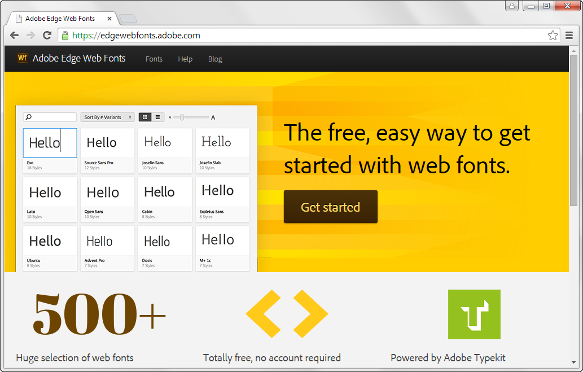
The Adobe Edge Web Fonts website

Slide 10

A heading that uses an Adobe Edge Web Font
The link element for importing an Adobe Edge Web font
<script src="//use.edgefonts.net/alex-brush.js">
</script>
The CSS that applies the Adobe Edge Web font
h1 { font-family: alex-brush, cursive; }

Slide 11
Link elements for screen and print style sheets
<link rel="stylesheet" href="styles/main.css">
<link rel="stylesheet" href="styles/print.css“
media="print">

Slide 12
A media query for printing at the end of a style sheet
@media print {
body {
font-family: "Times New Roman", Times, serif;
background-color: white;
}
}
A style element for printing in the head section of the HTML
<style media="print">
font-family: "Times New Roman", Times, serif;
background-color: white;
</style>

Slide 13
Recommendations for formatting printed pages
Change the text color to black and the background color to white.
Change text other than headings to a serif font to make the text easier to read when printed.
Use a base font size that’s easy to read when printed.
Keep the line length of the text to 65 characters or fewer.
Remove site navigation since it can’t be used from a printed page.
Remove as many images as possible, especially animated images.

Slide 14
CSS that uses two of the properties for printing
img { display: none; }
h1, h2, h3 { page-break-after: avoid; }

Slide 15
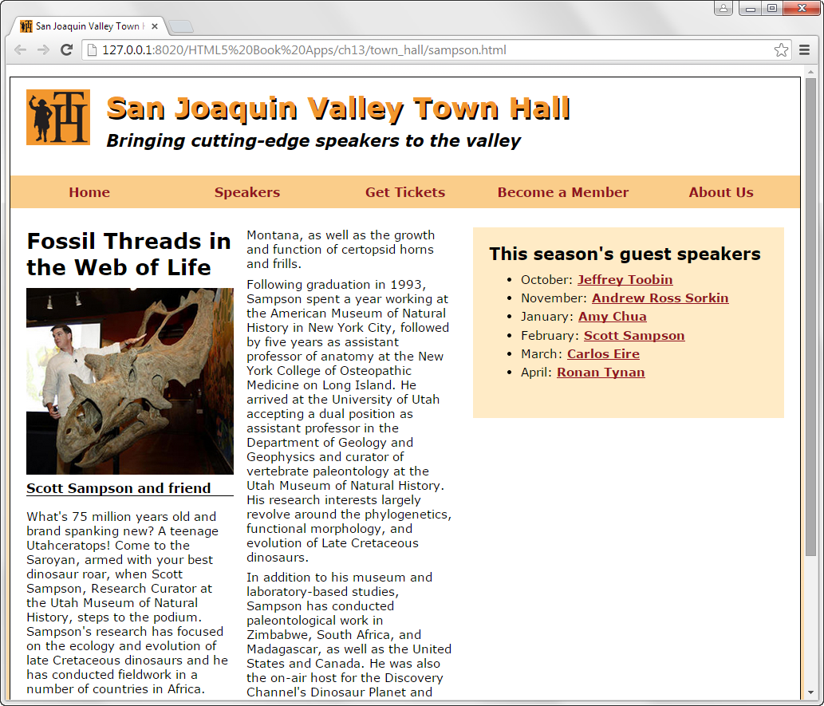
A web page with two columns

Slide 16
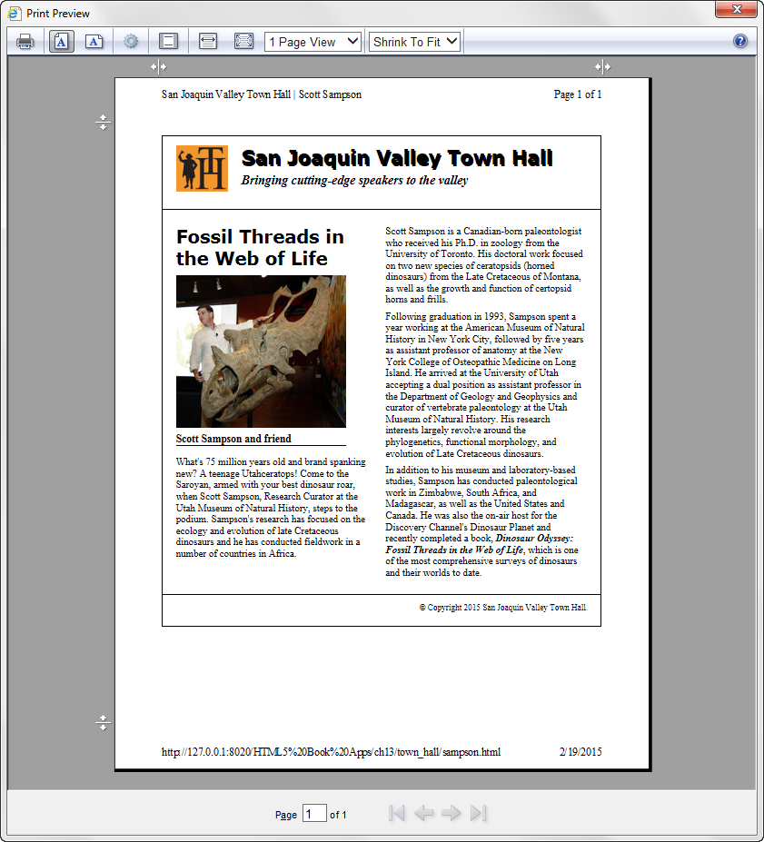
The layout for the web page in Print Preview

Slide 17
The link elements in the head section
<link rel="stylesheet" href="styles/speaker.css">
<link rel="stylesheet" href="styles/speaker_print.css" media="print">
Changes to the printed page
The navigation menu and side aren’t printed.
The headings, text, and borders are set to black.
The article is wider.
The font for the text has been changed to a serif font so it’s easier to read.

Slide 18
The style sheet for the printed web page
body {
font-family: "Times New Roman", Times, serif;
width: auto;
}
h1, h2 {
font-family: Verdana, Arial, Helvetica, sans-serif;
}
#nav_menu {
display: none;
}
aside {
display: none;
}
article {
width: auto;
}

Slide 19
The style sheet (continued)
header {
border-bottom: 2px solid black;
}
header h2 {
color: black;
font-size: 180%;
}
header h3 {
color: black;
font-size: 120%;
}
footer {
border-top: 2px solid black;
}

Slide 20

Short 15-1 Format the home page for printing

